Slide 1
Open
Day 2022
Scuola del Design
INFORMATION
www.design.polimi.it

Slide 2
02.
Deadlines
03.
Prerequisites
01.
Available
places
04.
Required
Documents
CONTENTS
05.
Evaluation
Criteria
07.
Curricular
Integrations
08.
Study Plan
06.
Rankings

Slide 3
01.
Available places

Slide 4
CLASS | LAUREA MAGISTRALE eq. To MASTER OF SCIENCE | LANGUAGE | SECTIONS | PLACES FOR STUDENTS WITH ITALIAN/UE TITLE
LM-12 | Integrated Product Design | Mixed IT/EN | IP1 ITA/ENG IP2 ENG | 70
LM-12 | Interior and Spatial Design | Mixed IT/EN | IS1 ITA/ENG IS2 ENG IS3 ENG | 80
LM-12 | Design della Comunicazione | Mixed IT/EN | C1 ITA/ENG C2 ITA/ENG C3 ENG | 105
LM-12 | Design for the Fashion System Design per il Sistema Moda | English | M1 ENG M2 ENG | 40
LM-12 | Product Service System Design Design del sistema prodotto servizio | English | PS1 ENG PS2 ENG | 40
LM-12 | Design & Engineering Progetto e ingegnerizzazione del prodotto industriale | English | D&E1 ENG D&E2 ENG | 65
LM-12 | Digital and Interaction Design | English | DID ENG | 30
Notes:
? COME VENGONO ALLOCATI SULLE SEZIONI? * Students may include at least 3 Italian-language courses in their study plan – vero?

Slide 5
02.
Deadlines

Slide 6
Application deadlines A.Y 2022-2023
Ist semester: from 04th July 2022 to 25th July 2022
2nd semester: from 9th January 2023 to 26th January 2023
NOTE: The second semester admissions will be open only in case at November 30th 2022 there are still unassigned places

Slide 7
Following deadlines
1st semester Application Deadlines | 2nd semester Application Deadlines only in case at November 30th 2022 there are still unassigned places
Application outcome/Rankings (incl. section) | Application outcome/Rankings (incl. section)
05th September 2022 | 13th February 2023
Enrolment | Enrolment
05th September 2022- 8th September 2022 Enrolment to single courses for curricular integration 05th September 2022- 14th September 2022 | 13th February 2023 – 14th February 2023 Enrolment to single courses for curricular integration 13th February 2023 – 16th February 2023
1st year study plan presentation | 1st year study plan presentation
05th September 2022- 8th September 2022 regular students 05th September 2022- 14th September 2022 curricular integrations’ students | 13th February 2023 – 16th February 2023 regular students 13th February 2023 – 16th February 2023 curricular integrations’ students
Publication of allocation of optional study plan elements (Section is assigned at the admission) 12th September 2022 from 3.00 pm | Publication of allocation of optional study plan elements (Section is assigned at the admission) 17th February 2023 from 3.00 pm
Repechage phase 12th September 2022- 14th September 2022 Publication of allocation of optional study plan elements 15th September 2022 from 3.00 pm | Repechage phase 15th February 2023 – 16th February 2023 Publication of allocation of optional study plan elements 17th February 2023 from 3.00 pm
Notes:
Qual è il termine per immatricolarsi nel ripescaggio? 14.9 e fare piano?

Slide 8
Conditionally admitted students
Students who at the moment of the application are still waiting to sit their final degree exams will be conditionally admitted. The deadline for completing the application is 30th November for 1st semester admissions and 31st March for 2nd semester admissions.
Within these deadlines, students must prove that they have obtained their degree, otherwise their application will be deactivated with the clause "application not processed".

Slide 9
03.
Prerequisites

Slide 10
Prerequisites
In order to be admitted to the assessment procedure:
graduate/undergraduate applicants from the Politecnico di Milano must have a weighted average of / greater than 23/30 (calculated at the time of application);
graduate/undergraduate applicants from other universities must have a weighted average of / greater than 25/30 (calculated at the time of application);
undergraduate applicants must have earned at least 145 ECTS credits, excluding the final examination, by the date of submission of the application;
applicants must have an appropriate English language certificate;
applicants must upload the required documents, within the application deadline.

Slide 11
Alert!
An appropriate English language certificate must be uploaded online within the application deadline. Applicants not providing any of the following English certifications will not be admitted to the assessment procedure.
Notes:
C’è la possibilità di chiedere in segreteria un’equivalenza? E se il corso di laurea era in lingua inglese?

Slide 12
04.
Required Documents

Slide 13
Documents
The documents required for the application’s assessment process are:
Projects’ portfolio max 20 MB, pdf file You can choose the graphic format you prefer
Curriculum/Resumé max 4 MB, pdf file highlighting any relevant additional educational activity and professional experience
Motivation Letter max 4 MB, pdf file, one file containing the letters for each Course option
Your previous study plan (Bachelor/Master) for students coming from other Universities max 4 MB, pdf file, including the weighted average rounded to the 2nd decimal place, marks obtained for each course and Scientific Disciplinary Sectors
Documents may be written in Italian or English.
Double check the instruction in Attachment 1 to the Admission guide for further details.
Notes:
The applicants can upload the Portfolio on the 1st option and duplicate it on the remaining options, or upload different documents for each option; the other documents will be uploaded once for all the Course options expressed.

Slide 14
Eligible candidates to direct admission
Candidates from the School of Design of Politecnico di Milano meeting the following merit criteria
Within the 10th of October of the second year of enrolment, Politecnico’s IT system calculates each student’s N and V parameters, referring to the earned CFU (N) and the weighted average (V)
These parameters entitle the students of the School of Design to a direct acccess to the Laurea Magistrale Programmes, if they are equal or more than:
N 114 CFUs
V 27 weighted average
For INTEGRATED, INTERIOR, FASHION Des., COMUNICATION, D&E:
N 114 CFUs
V 28 weighted average
For PSSD and DID
For Design & Engineering, students form Mechanical Engineering and Material Engineering can also be eligible to direct access, if their parameters are equal or more than:
N 105 and V 25.
Students admitted to the exchange Programmes MEDES and FIT are eligible to direct access to the Lauree Magistrali in continuity.
Notes:
Io salterei questa parte perché la presentazione è per gli esterni

Slide 15
05.
Evaluation Criteria

Slide 16
Evaluation criteria
CAREER PARAMETERS max 40 points |  | DOCUMENT PARAMETERS max 60 points
Weighted average in 30 points | Continuity bonus | Portfolio | PROFESSIONAL ACTIVITIES | EDUCATIONAL ACTIVITIES* | Total
Max 30 | Max 10 points | Max 30 points | Max 10 | Max 20 | Max 100
For more details check annex 2 | 10 points continuity degree course School of Design with continuity Masters Degree courses (for DID and PSSD all the degree courses of the School of Design - for D&E also Classes L8 and 9 Polimi) 5 points all Class L-4 CdL School of Design not of continuity and CdL other Universities (for DID and PSSD all other Universities - for D&E also Class L8 and 9 other Universities) 0 points for other Degree Classes, Academic Schools and ISIAs For details see Annex 3 | from 0 to 17 points not sufficient equal to or greater than 18/30 positive | additional experience in the Design Sector (e.g. short extracurricular internships, participation in competitions, etc.) professional experience in the Design Sector (e.g. medium-long term extracurricular internships, etc., related to Design) | Supplementary or extracurricular tuition Erasmus, single courses, workshops, Passion in action courses * The student must specify these activities even if they were done at Politecnico

Slide 17
06.
Rankings

Slide 18
Publishing of the Rankinks - 5th September
DIRECT ADMISSION RANKING
Available places will be first assigned to candidates from Politecnico’s School of Design, entiled to direct admission (no need of further evaluation).
In case the eligible students outnumber the available places, they will be listed according to a merit ranking, based on the weighted average.
In case the first option ranking has already assigned all the available places, students will be placed on their second option ranking.
2. MERIT RANKING
The other applicants will be ranked in a merit list, according to the total score obtained by the application, the order of preferences the Master's Degree Courses and the available places, after direct admissions.
The merit ranking will show only candidates with a Portfolio’s positive evaluation (min. 18/30 points).
The score awarded to the applicants to the second option will be reduced of 20% and of 25% in case of third option.
CANDIDATES THAT ARE ELIGIBLE FOR ENROLMENT IN THEIR FIRST OPTION, WILL SHOW ONLY IN THAT RANKING – THEY WILL NOT SHOW IN OTHER LM RANKINGS
Candidates that are eligible for enrolment in their 2nd/3rd option will show in their 1st/2nd option rankings only if waitlisted.

Slide 19
2nd Phase – Scrolling Ranking- 12th September
At the end of the enrolment period, a second phase will be open, where the places left free from the first phase will be made available. Candidates will show only once, in the most favorable scrolling ranking.
For each Programme (CdS) will be excluded from the relevant scrolling ranking:
• students already enrolled in any of Politecnico’s Degree Programmes;
• students who were already eligible for enrolment in the programme and have not exercised their right to do it.
Unassigned places after the second phase will be made available for selections in the 2nd semester.
The relevant notice will be published in early December on the School’s website.
.

Slide 20
07.
Curricular Integrations

Slide 21
Assignment and fulfillment of curricular integrations
Access to non-continuing Master's degree courses may involve the assignment of curricular integrations, i.e. the need to attend and pass first level courses, before reapplying to the Master Degree.
There will be special rankings for Candidates admitted to the enrolment with curricular integrations.
If a candidate is eligible to enrolment in any option (regardless the need of curricular integrations) he/she will not show in rankings of the following options
Candidates admitted to the enrolement with curricular integrations must enrol in single courses.
Once the curricular integrations have been completed, students have to submit again the application for admission in the MSc Program, uploading again the required documentation – updating it with additional projects and further professional experiences, if any.
Passing the assigned curricular integrations, DOES NOT give priority in the merit rankings and DOES NOT guarantee the admission to the MSc Programme.
In the event that there are no places available for admission in the 2nd semester, the candidate enrolled in single courses will have to reapply the following academic year.

Slide 22
08.
Study Plan

Slide 23
Study Plan
Students admitted in the MSc Programs are assigned to their section when admitted to the Programme and it can't be modified.
After the enrolment, students must submit a study plan, registering all the optional elements (elective courses in the first year and other optional courses within the MSc Program).
The Study Plan must be submitted on an annual basis.
Each student can decide how many credits (CFU) register in the study plan from 30 to 80 CFU. The standard plan foresees 60 CFU per AY.
Before submitting the study plan, students are required to check the courses details (contents /language/professor/timetable…) on Polimi website.
The allocations in the optional courses is based on a merit ranking considering the academic average declared in the application.
The allocations will be published on the personal area of online services_career on 12th September. Before attending the lessons, students need to verify their allocations.

Slide 24
Study Plan for students with Curricular Integrations
Students enrolled to curricualr integrations can anticipate some courses from the desired MSc Program, adding them to their study plan until a maximum of additional 32 CFU.
The Study Plan cannot exceed 80 CFU: the sum of the credits from the curricular integrations + the credits from the MSc anticipated courses, cannot exceed this value.
Students with Curricular Integrations will be allocated to Sections or Optional Courses of the Master Degree after regularly enrolled students, on the basis of the places still available.

Slide 25
AMBASSADOR
High-level training courses aimed at creating new professional figures in
GREEN TECHNOLOGIES , SMART INFRASTRUCTURES and INCLUSIVITY DESIGN
Have skills in specific areas consistently with the training project (green/smart/inclusivity)
Acquire enabling digital technologies in line with the profile
Master interdisciplinary tools, methods, and aptitude for a systemic vision
Develop talent to operate in interdisciplinary and multisectoral contexts acquired through exposure, even in teams, to case studies and challenge

Slide 26
AMBASSADOR - What
Study plan of at least 132 CFU (120 + 12 CFU)
30 credits Green or Smart or Inclusive
12 CFU
18 CFU (at least)
+
EFFECTIVE COURSES WITHIN THE MSc
Characterizing courses
(Table A)
6 CFU EFFECTIVE COURSES
+
12 CFU EXTRA COURSES (at least)
Transversal courses
(Table B)
The specific Ambassador certification will be reported in the Student’s Diploma Supplement
and a digital badge will be issued by Politecnico di Milano.

Slide 27
AMBASSADOR - Which
MSc PROGRAM | GREEN TECNOLOGIES | SMART INFRASCTRUCTURES | INCLUSIVITY DESIGN
Integrated Product Design | X | X
Communication Design |  | X | X
Product Service System Design |  | X | X
Digital and Interaction Design | X
Design & Engineering | X | X

Slide 28
09.
School Contacts

Slide 29
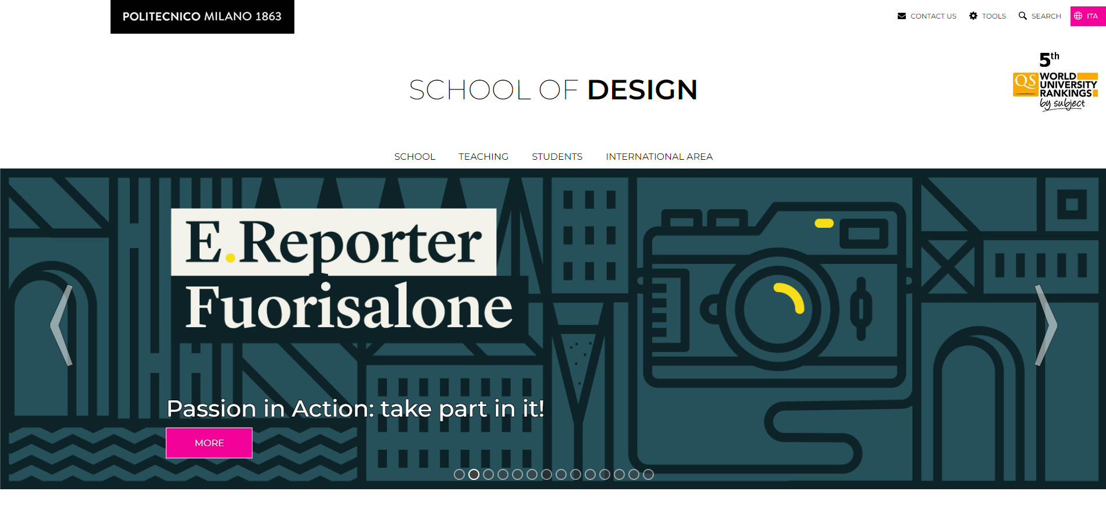
www.design.polimi.it

Slide 30
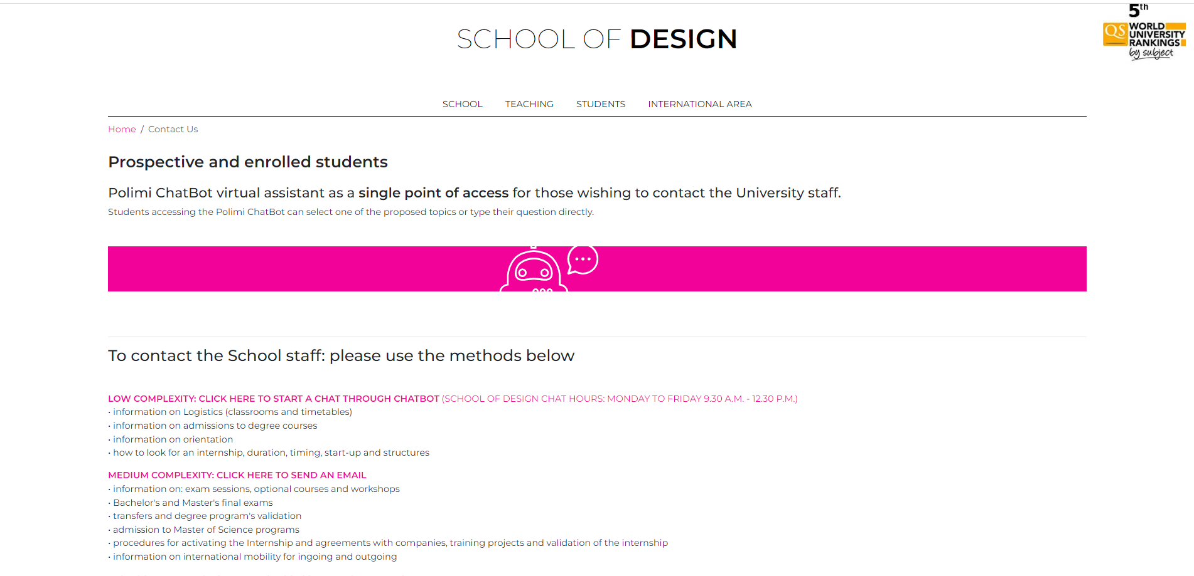

Slide 31
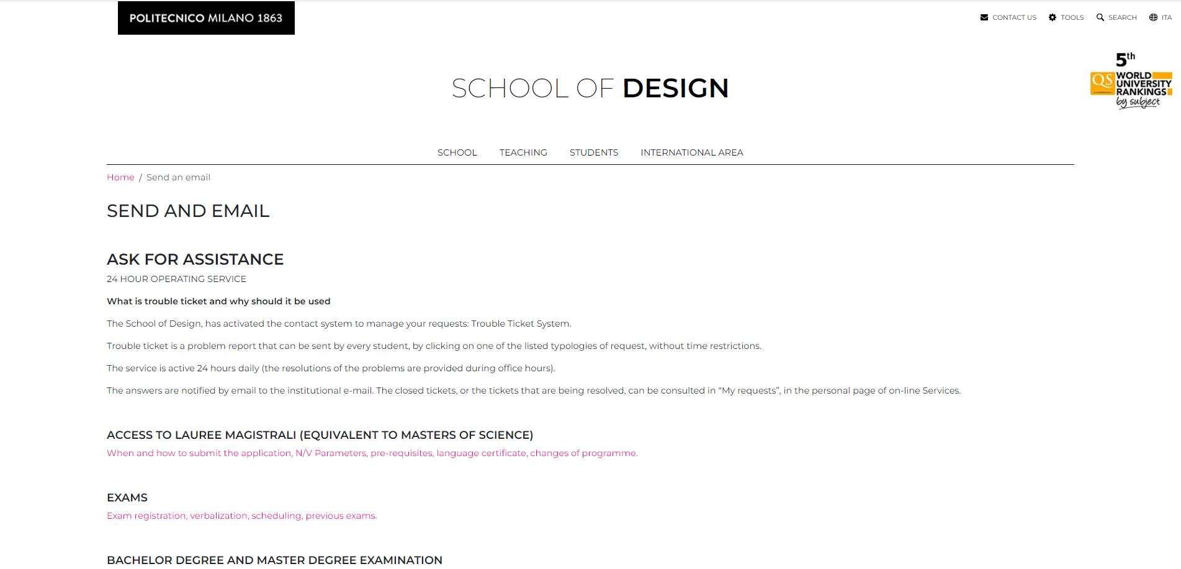

Slide 32
Thanks!
More info:
www.design.polimi.it

